Slide 1

What is the Devereux Early Childhood Assessment (DECA) Program?
Notes:
The purpose of this PowerPoint slide deck is to help you introduce and explain the Devereux Early Childhood Assessment (DECA) Program to others (colleagues, parents/families, funders, etc.). It is NOT meant to train on the use of the program.

Slide 2
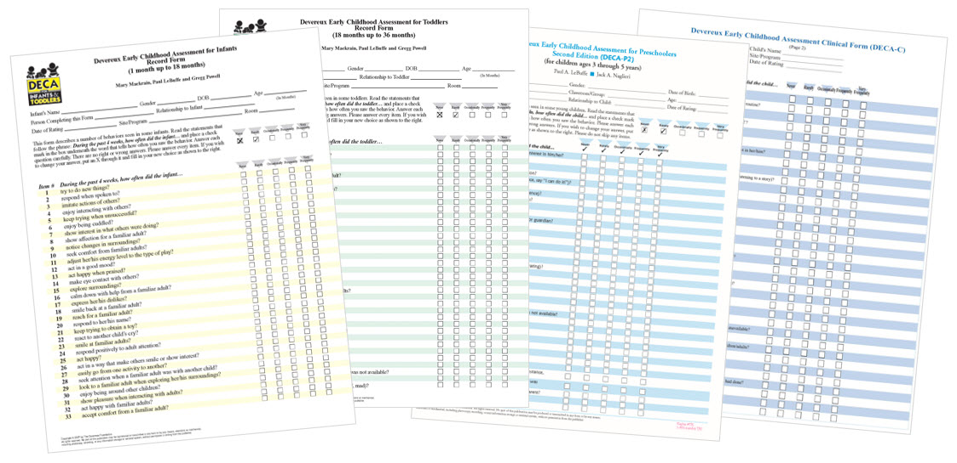

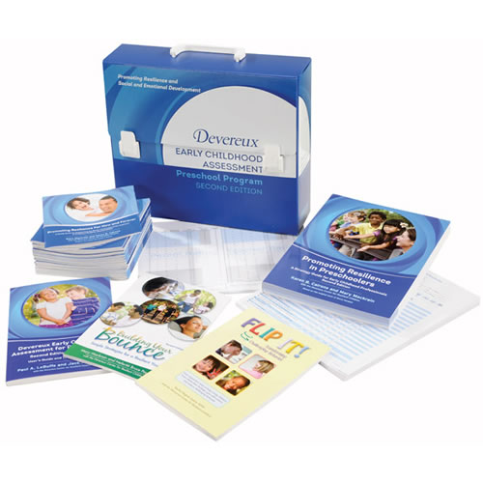
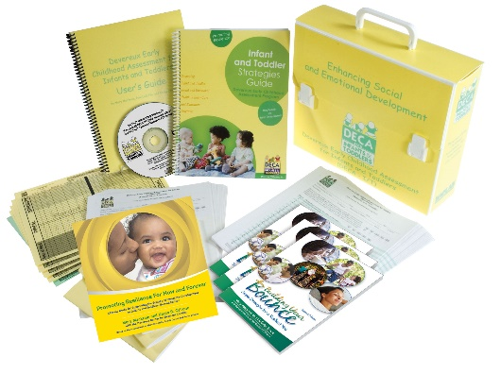
Devereux Early Childhood Assessment (DECA) Program
Notes:
Early childhood professionals know how important social and emotional health is for young children, but they don’t always know how they can teach children critical social and emotional skills. The beauty of the DECA Program is that it takes the best of what research tells us children need, and puts it into a practical framework that teachers can use every day in the course of their lesson plans and daily activities to teach social and emotional skills, thereby promoting a child’s resilience.
The core of the DECA Program is a nationally standardized, reliable, and valid assessment that allows teachers to assess how each and every child in the classroom is doing with respect to three key social and emotional skills – developing healthy relationships, learning to regulate their emotions, and showing initiative. Completing the assessment takes about five minutes, and a version is available for infants, toddlers, and preschoolers. When using the web-based version of the assessment tool, teachers get instant access to the child’s scores. Teachers can then select appropriate strategies so that the assessment information immediately is used for planning. Parents can also complete the same assessment, allowing teachers and parents to work together so that the same strategies are being implemented at both home and school.
The DECA Program shows teachers how to use ordinary opportunities throughout the day - whether it be drop off, meals, or small group activities - as skill-building and teachable moments. When teachers learn that they don’t need to do “more,” but rather, learn how to think differently about their routines and lessons, they feel empowered. They see that implementing the DECA Program is possible, that it makes their day-to-day teaching experience better, that children can learn social and emotional skills, and that they truly can make a difference in the life of each and every child in their care.

Slide 3

Resilience
The ability to bounce back
The ability to overcome misfortune or change
Notes:
The DECA Program is based on the science of resilience. Merriam-Webster defines resilience as “the ability to recover from or adjust easily to misfortune or change.” A resilient person copes and “bounces back” when faced with stress, change, or risk factors – negative influences in a person’s life. Someone who is resilient can identify problems, find ways to address challenges, recover quickly, and move forward. A resilient person has many protective factors – characteristics, people, and supports – that help a person get through tough times.
Think about resilience as a rubber band. A rubber band can be stretched and stretched, but can also return to its original shape. Resilient individuals experience stress and challenges (are pulled like a rubber band), but have people in their lives, have been taught skills, and have access to resources that help them bounce back, recover, and move forward with life.
The science of resilience helps us to understand that promoting a child’s resilience can happen in the earliest days of life, and that these early years are a critical time to surround children with protective factors and reduce their exposure to risk factors.

Slide 4

Risk
Factors
Protective
Factors
Notes:
Understanding resilience involves understanding the relationship between two key concepts: risk factors and protective factors. Resilience is the process by which individuals are able to obtain positive adaptation in the context of risk or adversity (Masten, 2014). People who have shown resilience have experienced risk in their lives, such as abuse or neglect, poverty, or natural disasters. These and other risk factors are known to increase the likelihood that an individual will experience negative outcomes related to their health, development, or well-being (Goldstein & Brooks, 2005). Despite experiencing this risk or adversity, individuals described as resilient have done well either in the midst of, or following, these negative experiences. They show better than expected outcomes in their development and functioning.
A key finding from decades of research is that resilience is common and arises from basic human resources and protective factors (Masten, 2001). Ann Masten, a well-known resilience researcher, refers to resilience as “ordinary magic.” Resilience is not a rare occurrence that results from extraordinary talents, instead, it is common and results from protective factors such as having a close relationship with a caring and competent adult, safe and effective schools and communities, and belief in yourself and motivation to succeed. These basic protective factors help at-risk children achieve greater success than might have been possible if they did not have these characteristics.
These images of rain and umbrellas help illustrate how resilience works. All individuals experience some level of risk in life (rain) and when this happens, the most effective way to move forward and bounce back is to utilize protective factors (umbrellas). Umbrellas don’t stop rain from falling, but they do help to protect us during the storm.

Slide 5
Resilience Model
RISK FACTORS
PROTECTIVE FACTORS
ENVIRONMENT
ENVIRONMENT
FAMILY
FAMILY
WITHIN
WITHIN
Negative:
VULNERABILITY
Positive:
RESILIENCE
Outcome
Notes:
This is another image to help explain the concept of resilience. Resilience focuses on understanding the balance between risk factors in a person’s life (the challenges and adversities) and protective factors (the elements of an individual’s personality and background that help them succeed when faced with challenges). This visual helps convey the message that both risk and protective factors can be found externally-- within our environments and our families and internally, within ourselves. A growing body of research confirms that many internal protective factors found within ourselves can be learned, practiced and sought out. By strengthening our protective factors, it helps tip the balance of the scale toward resilience. Following are examples of risk and protective factors within these three levels:
Environmental Risk Factors Environmental Protective Factors
Poverty Social services
High crime communities Safe playgrounds
Systemic racism Caring and skilled teachers
COVID-19 Access to quality health care
Family Risk Factors Family Protective Factors
Parental Mental Illness Loving and stable family
Incarcerated Parents Extended family
Divorce Healthy family
Within Risk Factors Within Protective Factors
Depression Good physical and mental health
Health problems A talent/skill/hobby
Low self-esteem Social and Emotional Skills

Slide 6
Why Does It Matter?
Resilience Model
RISK FACTORS
ENVIRONMENT
FAMILY
WITHIN
PROTECTIVE FACTORS
ENVIRONMENT
FAMILY
WITHIN
Negative:
VULNERABILITY
Positive:
RESILIENCE
Outcome
Notes:
Continuing with the visual of a scale, the goal of the DECA Program is to help teachers and parents tip the scale of every child toward resilience and positive life outcomes. Reducing the number of risk factors that a child experiences and increasing protective factors helps achieve this goal. When teachers understand that they can serve as protective factors to children and when parents learn that they are the most important protective factor in their child’s life, this helps to tip the scale toward more positive outcomes. And, when both teachers AND parents learn that teaching children social and emotional skills through the most ordinary interactions and activities of the day can greatly enhance children’s healthy development, this also tips the scale. The DECA Program is designed to teach parents and teachers how to promote three critical within-child protective factors that are in fact social and emotional skills. These three factors are: healthy relationships; self-regulation and initiative.

Slide 7
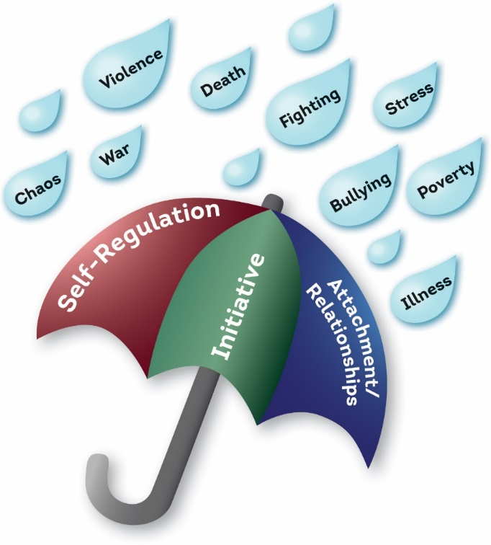
DECA Program Protective Factors
Notes:
The three within-child protective factors that are measured by the Devereux Early Childhood Assessment are defined below. The visual of an umbrella reminds us that risk factors such as those depicted in the rain drops may be experienced by some young children and that promoting children’s social and emotional skills can help protect them. Decades of research support the importance of promoting the following social and emotional skills in young children.
Attachment/Relationships: The child’s ability to promote and maintain mutual, positive connections with other children and significant adults.
Self-regulation: The child’s ability to respond to many different emotions using words and actions that are appropriate for the different situations he/she encounters. For toddlers, self-regulation is defined as the child’s ability to actively control arousal and his or her response to it.
Initiative: The child’s ability to use independent thought and action to meet his or her needs.

Slide 8
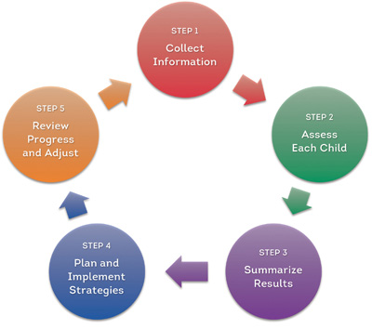
The DECA Program’s Five Steps
A comprehensive assessment and planning approach
Notes:
The Devereux Early Childhood Assessment (DECA) Program is designed to foster young children’s resilience using a comprehensive assessment and planning process that involves families and professionals working as partners. The significant adults in a child’s life work together to collect information – including social and emotional screening and assessment data – and use the information to develop plans that promote children’s social and emotional skills. Families, educators, consultants and other significant adult caregivers continuously monitor, evaluate and modify the plans as needed – ensuring positive outcomes. This comprehensive process takes place in 5 steps as explained below:
Collect information by (1) Observing children and (2) Collecting information on the quality of the home and school environments that impact behavior and social and emotional skill development.
Assess each child using the DECA, a nationally standardized, valid and reliable measure of within-child protective factors
Summarize results of the DECA to understand a child’s unique strengths and areas of need.
Plan strategies for individual children and the group as a whole to address areas of need and build on existing strengths.
Evaluate progress to ensure that children’s social and emotional skills are improving and adjust plans accordingly when necessary to meet identified goals.

Slide 9
Step 1 – Collect information
STEP 1
Collect Information
Get to know each child and family
Conduct observations
Complete the Reflective Checklists
Notes:
The Devereux Early Childhood Assessment (DECA) is a behavior rating scale that asks raters to share their perceptions about a child’s behaviors over the course of the past four weeks. Step 1, Collecting information, involves
intentionally observing children’s behaviors in preparation for conducting a rating using the DECA. It is highly recommended that organizations implementing the DECA Program communicate with the teaching staff about the
importance of observing children in their natural settings and using their knowledge about how to conduct accurate, objective and complete observations. In addition to observing children’s behaviors, it is recommended that
teaching staff use a tool to collect information about elements of the classroom such as the physical environment, interactions, routines, activities and partnerships with families that have a direct impact on behavior and social
and emotional skill-building.
Devereux offers optional resources to support Step 1, available on our website at www.centerforresilientchildren.org.

Slide 10
Step 2 – Assess each child with the DECA
STEP 2
Assess Each Child
Complete the DECA on every child in the group/classroom, and encourage families to rate their child as well
Notes:
The Devereux Early Childhood Assessments (DECA) are nationally standardized, valid, reliable, strength-based behavior rating scales. A form for Infants (4 weeks – 18 months); toddlers (18-36 months) and preschoolers (3 through 5 years) measure young children’s within-child protective factors and can be completed by both parents and teachers. As a strength-based, primary prevention tool, the DECA is appropriate for all children.
The scale structure for the forms varies slightly. The infant form measures Attachment/Relationships and Initiative; The toddler form measures Attachment/Relationships, Initiative, and Self-regulation; the preschool form measures Attachment/Relationships, Initiative, Self-regulation and also includes a behavioral concerns screener.
These different versions of the record form include different norms tables that are used to obtain scores based on the child’s chronological age at the time of the rating. In addition, different norms tables are offered for parent and teacher ratings, as the standardization process revealed differences in how these two rater types viewed children’s behavior.
The qualifications needed to conduct a DECA rating include knowing the child for a minimum of four weeks and being able to read English or Spanish (the DECA is standardized in both languages). If parents are challenged by reading the form, Devereux recommends that a teacher read the questions in a neutral voice so as to avoid influencing the parent rating.

Slide 11
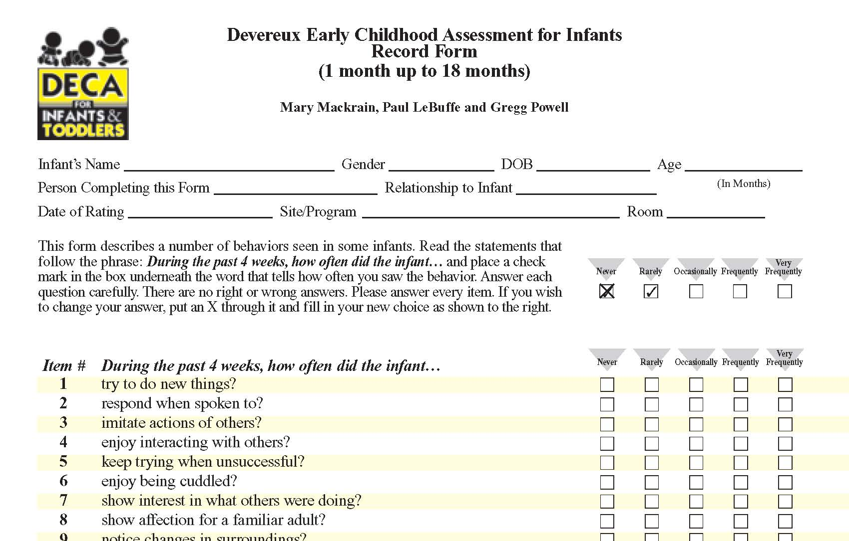
DECA Infant (DECA-I) Record Form
4 weeks up to 18 months old
Notes:
This image shows what a DECA for Infants form looks like. The information that is needed to accurately score the tool is at the top, followed by the instructions. The image also shows the first 10 items of the 33 item behavior rating scale. The form is available in English and Spanish.

Slide 12
I
DECA Infant Scales Structure (1-18mo)
DECA-I
Total Protective Factors
Initiative
Attachment/ Relationships
Notes:
This image shows the two within-child protective factors measured by the DECA for Infants. The two scales (Initiative and Attachment/Relationships) can be combined to provide a Total Protective Factor score.
The process used to create the DECA is called factor analysis. This psychometric process can be used to organize the questions about behaviors into groups or scales. For infants, factor analysis revealed that the behaviors clustered together in two scales, not three as the Toddler and Preschool form. A closer look at the items and an understanding of child development helps to reveal that children at this age are still learning to self-regulate through their attachment and relationships with adults. The behaviors related to self-regulation don’t form their own group/scale until children get a bit older (as seen in the toddler scale).

Slide 13
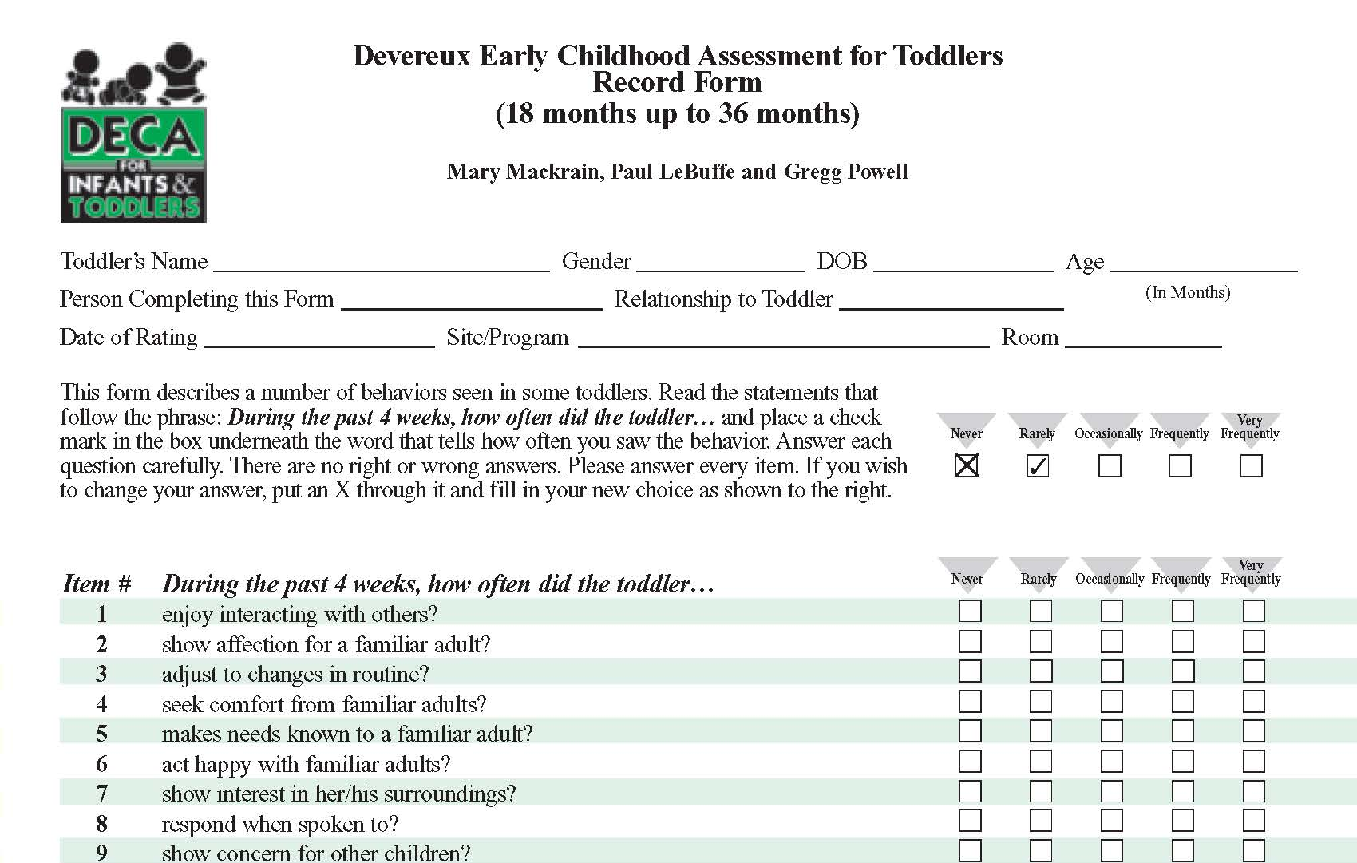
DECA Toddler (DECA-T) Record Form
18 to 36 months old
Notes:
This image shows what a DECA for Toddlers form looks like. The information that is needed to accurately score the tool is at the top, followed by the instructions. The image also shows the first 10 items of the 36 item behavior rating scale. The form is available in English and Spanish.

Slide 14
T
DECA Toddler Scales Structure (18-36mo)
DECA-T
Total Protective Factors
Initiative
Self-Regulation
Attachment/ Relationships
Notes:
This image shows the three within-child protective factors measured by the DECA for Toddlers. The three scales (Initiative, Self-regulation and Attachment/Relationships) can be combined to provide a Total Protective Factor score.

Slide 15
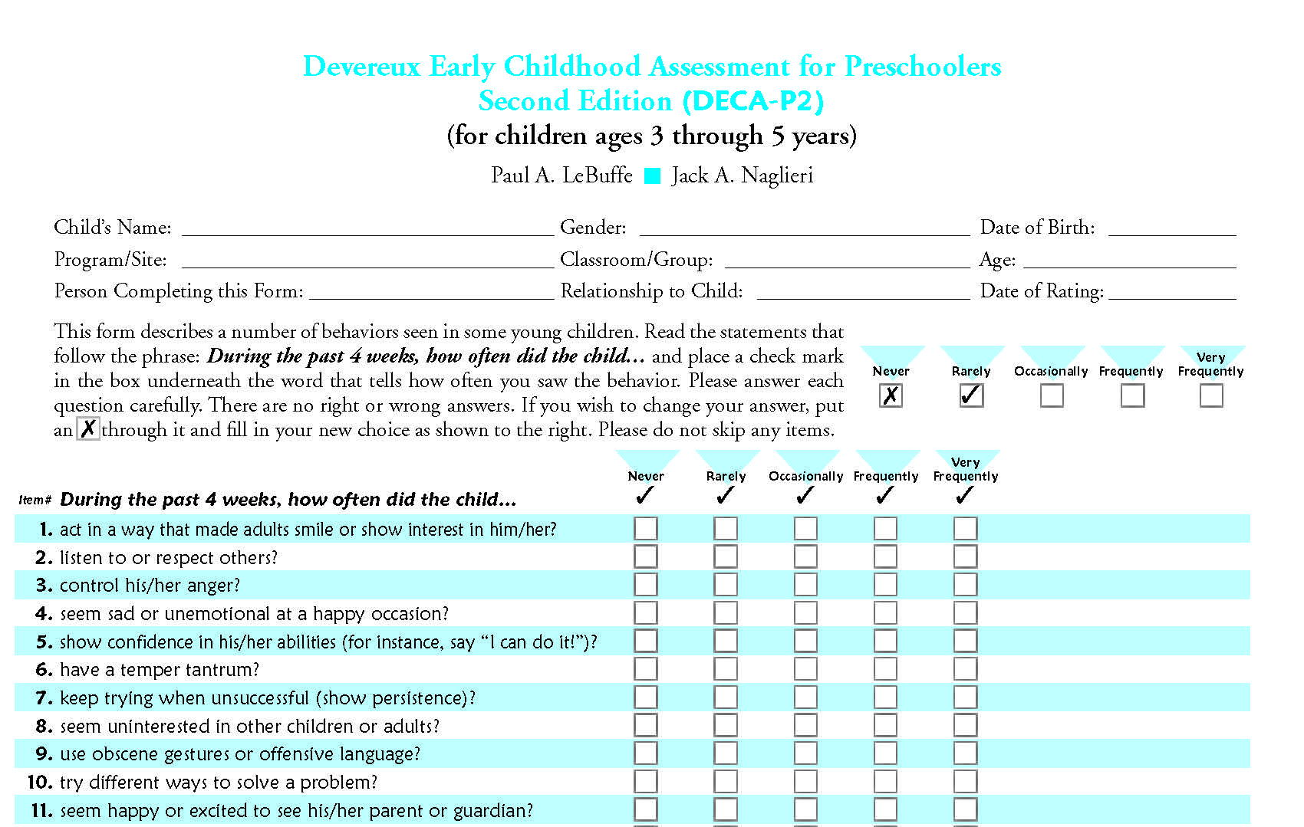
DECA Preschool (DECA-P2) Record Form
3 through 5 years old (up to 6th birthday)
Notes:
This image shows what a DECA for Preschoolers 2nd edition form looks like. The information that is needed to accurately score the tool is at the top, followed by the instructions. The image also shows the first 10 items of the 38 item behavior rating scale. The form is available in English and Spanish.

Slide 16
P
DECA P2 Scales Structure (3yr-5yr)
DECA-P2
Total Protective Factors
Initiative
Self-Regulation
Attachment/ Relationships
Behavioral Concerns
Notes:
This image shows the three within-child protective factors measured by the DECA for Preschoolers, 2nd edition. The three scales (Initiative, Self-regulation and Attachment/Relationships) can be combined to provide a Total Protective Factor score. In addition, an 11 item scale screens for behavioral concerns and includes behaviors that are both externalizing (aggressive behaviors) and internalizing (withdrawal / avoidance behaviors).

Slide 17
Standard Scores
  Percentiles: Percent of children receiving the same or lower score
  T-scores: Mean is 50, Standard Deviation is 10
  Description Ranges:
Protective Factor Descriptions
  T-scores of 60 and above = strength
  T-scores of 40 and below = area of need
  T-scores of 41-59 = typical
Behavioral Concerns (Preschool) Descriptions
  T-scores of 60 and above = area of need
  T-scores of 59 and below = typical
Notes:
The results of a DECA can be expressed using standard scores and description ranges. Two standard scores include T-Scores and Percentiles.
The T-scores can be used to generate description ranges which are often more easily understood than the standard scores. The ranges are: Strength, Typical and Area of Need.
For the protective factors, it is desirable to have scores in the strength range as well as the typical range. Scores in the area of need range indicate that this child is not showing the behaviors as frequently as desired and deserve attention and action planning. For behavioral concerns, typical scores are desirable and scores in the area of need range indicate that the child is showing negative behaviors with more frequency than is desired.
Devereux recommends focusing on strengthening protective factors for all children, with a focus on those children with areas of need. For children showing behavioral concerns, Devereux recommends first looking at the protective factors to determine if skill building in those areas will reduce the child’s need to use challenging behaviors to meet his/her needs. The DECA, as long as it is combined with other forms of information, can be used to determine if additional supports are needed to address a child’s behavioral concerns. Devereux does offer a tool called the DECA-Clinical form for those children’s whose challenging behaviors are extreme. To learn more about the DECA-Clinical form, head to our website at www.centerforresilientchildren.org.

Slide 18
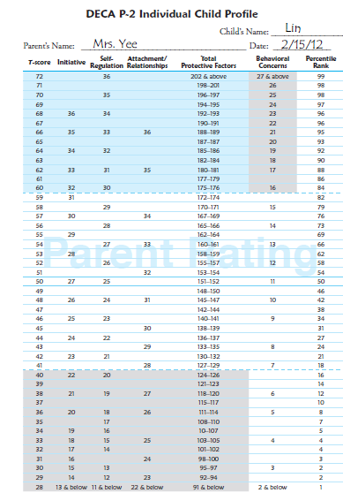

IN
SR
A/R
TPF
BC
Individual Profile for Lin, a child with Typical results
Strength
N
E
E
D
Typical
T
Y
P
I
C
A
L
Area of Need
Notes:
The results of a child’s DECA rating are plotted on a profile to help understand and communicate the results. As seen in this image, the profile includes the standard scores (T-scores on the far left column and Percentiles on the far right column). The description ranges for the individual protective factors and total protective factor score are clearly marked with Strength; Typical; and Area of Need. For Behavioral Concerns, there are two description ranges, Area of Need and Typical. While very low frequency of behavioral concerns is desired, the description of Typical is used rather than Strength.
This sample profile for a child, Lin, illustrates that his scores are in the Typical range, and this profile is typical of many children. However, notice that Initiative and Attachment are significantly lower then Self-Regulation. It is recommended to keep an eye on areas near the Area of Need range and even reflect and plan to strengthen these areas. .
A watermark in the middle of the form says “parent rating” which means that this profile reflects the results of a family member who rated Lin using the DECA. The DECA Program offers guidance around how to effectively share the results with family members using a process called Strengths, Goals and Strategies. An explanation of that process is found in the slide explaining Step 4, Planning.

Slide 19
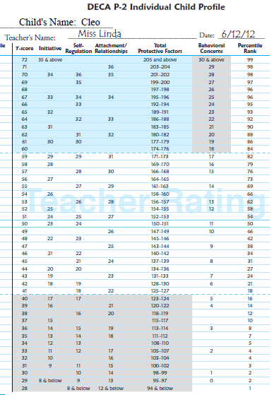

IN
SR
A/R
TPF
BC
Individual Profile for Cleo,
a child at risk
Strength
N
E
E
D
Typical
T
Y
P
I
C
A
L
Area of Need
Notes:
This sample profile shows a child who has protective factor scores in the area of need range and who has behavioral concerns in the Typical range. This sample profile really drives home the importance of the DECA as it reveals that a child’s social and emotional skill development is compromised, despite the fact that the child is not yet showing behavioral concerns in the Area of need Range. The DECA Program is designed to use this data to put actions and strategies in place to strengthen these protective factors as soon as possible, and behavior the behavioral concerns become elevated.

Slide 20
Step 3 – Summarize results
STEP 3
Summarize Results
Complete the group/classroom profile
Prepare for group planning
Prepare for individual child planning
Notes:
Step 3 of the DECA Program incudes looking at the DECA ratings for a classroom of children all together (see next slide) as well as reflecting on each individual child’s results in preparation for planning.
In best practice, a teacher with a group of children will have protected time to review and reflect on the unique strengths and needs of each child in her/his classroom as well as how all the children are functioning as a whole group. This protected time to pause and reflect on what the DECA ratings reveal about each child is critical in moving onto Step 4 where action planning begins. Intentional, thoughtful reflection will support a more effective and efficient action planning process.

Slide 21
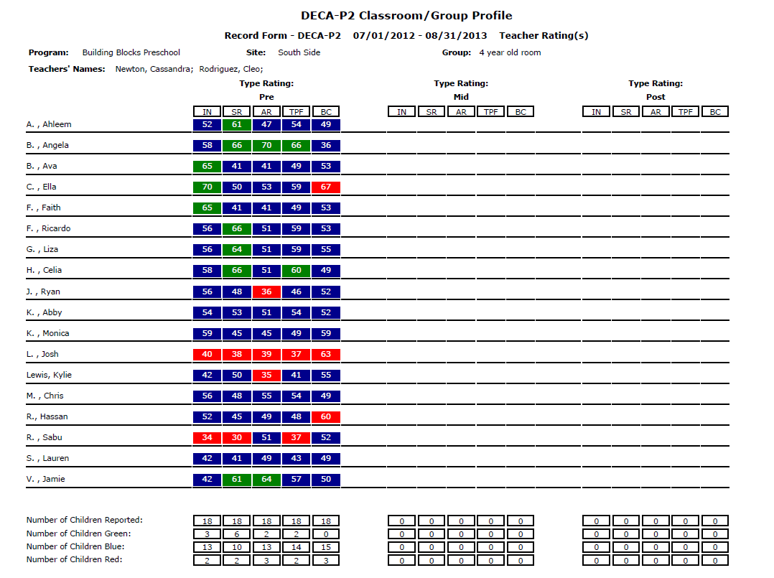
Notes:
The Classroom Profile offers a birds-eye view of the strengths and needs of the group to inform classroom planning around strengthening the protective factors. Each column is labeled to illustrate the results for Initiative (IN); Self-regulation (SR); Attachment/Relationships (A/R); Total Protective Factors (TPF) and Behavioral Concerns (BC). Green indicates a Strength; Blue indicates Typical and Red indicates an Area of Need. The T-score that was used to derive that description range can be found within the colored box for each of the protective factors.
In this sample profile, it shows a group of children whose combined greatest strengths are in the area of Self-regulation (6 children showing a strength in that area) and whose greatest areas of need are Attachment/Relationships and Behavioral concerns (each showing 3 children in that area). The DECA Program guides teachers to use this information for group planning, suggesting strategies and tips for strengthening any areas of need by using universal, developmentally appropriate practices with a laser focus on protective factors. In this scenario, a teacher could reflect on how to make the classroom overall a place where children truly feel that each and every one of them is an important member of the group to promote overall Attachment/Relationships. Strategies and ideas for how to do this can be found in the DECA Program strategy resources as well as other teaching resources. Teachers may come up with good ideas from past experiences, in conversations with colleagues and from their own creative reflections.
This form (as well as the Individual Child Profiles) can also be used to reflect on each child’s individual strengths and need. A look at this form would highlight that Josh is struggling across the board with social and emotional skills while Angela is showing tremendous strengths. This information could be used to try to partner Josh with Angela for some activities as a way to use peer partnerships as a strategy to use Angela’s strengths to support Josh’s needs.

Slide 22
Step 4 – Plan and implement strategies
STEP 4
Plan and Implement Strategies
Plan for the group
Plan for each individual child
Notes:
Step 4 is when teachers take all of the information that they have gathered and reflected on including observations, DECA ratings, conversations with family members and colleagues, and decide on a plan of action. The DECA Program encourages teachers to use a process that identifies Strengths, Goals and Strategies for individual children as well as the Group.
For a Group, this process should involve an appreciation for what is going well and using those successes to meet identified needs. In the case of the sample classroom profile in the prior slide, a teacher may realize that building the group’s attachment/relationships could involve the creation of a process to incorporate information from families about their traditions, culture, and favorite family routines. Knowing that the group is doing well in self-regulation may prompt the teacher to recognize how the children’s ability to wait their turn and listen could really support the success of a system where students wait while the teacher shares information and focuses on the information from each and every child.
The DECA Program encourages teachers to reflect on an individual plan for each and every child, even when the child has all strength and typical DECA scores. Although a plan for children in the Strength and Typical range may not be written down, the plans should be intentional. When a child has a DECA score that is an Area of need, a more targeted plan should be created in written form. In targeted planning, the team chooses strategies that add something more in terms of intensity, frequency and duration.

Slide 23
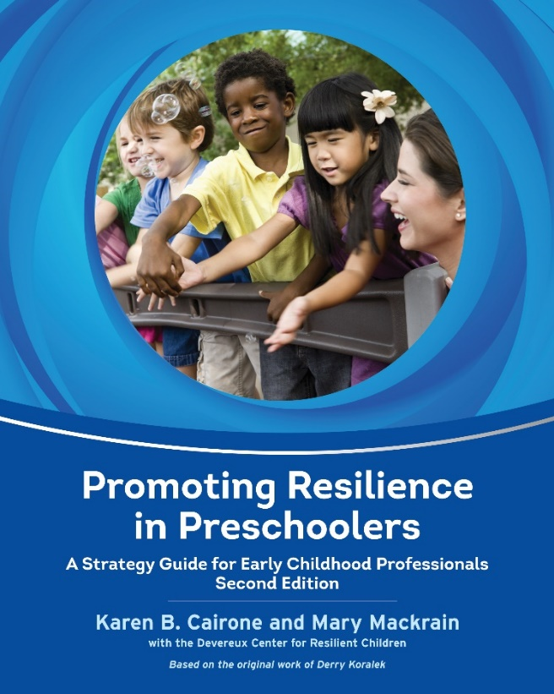
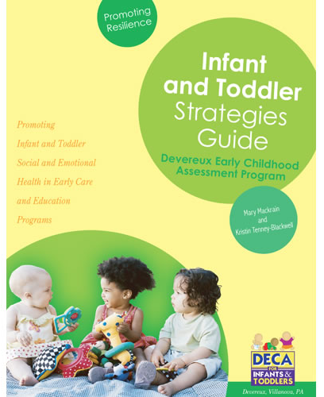
Teacher Strategies
Tips and strategies link to assessment results
Tips for individual children and the group
Notes:
The DECA Program offers strategy guides for teachers. These two images are the covers of two guides, one for Preschoolers and one for Infant/Toddlers, that layout a variety of strategies and explain to teachers how these various activities can be used to promote Initiative, Self-regulation and Attachment/Relationships for both individual children and the group as a whole. In addition, for programs that adopt the web-based assessment system, a subset of the strategies offered in these guides have been integrated into the software program. Whether teachers use the strategies from these guides, from the web-based system, or from other resources, the most important thing is that assessment data lead to action. Conducting a DECA rating and even reflecting on the results is only meaningful if some steps are taken to use that information to build on a child’s strengths and meet any identified goals.
In best practice, Step 4, Planning involves communication between teachers and families.

Slide 24
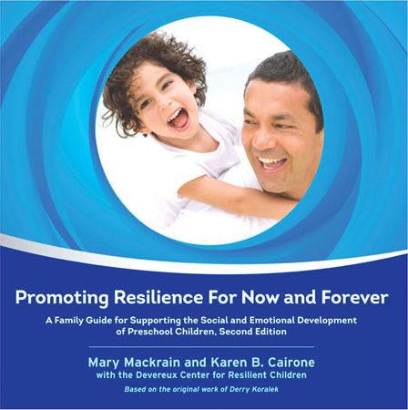
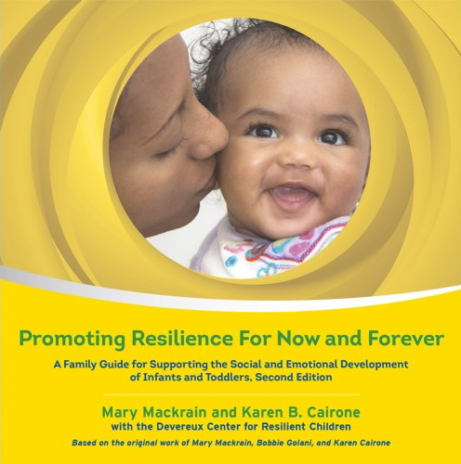
Parent/Family Strategies
Parent-friendly
Tips are part of everyday routines
Tips connect what we do NOW to lifelong, FOREVER behaviors
Notes:
The DECA Program emphasizes the importance of sharing information about resilience with families. In best practice, parents are invited to complete a rating on their child and then meet with teaching staff about the results. Just as teachers are asked to use a strengths, goals and strategies approach to action planning, so are families. No matter what a child’s DECA ratings are, families should be invited to reflect on the results and then use that information to build upon existing strengths and target areas of need for goal setting.
These family guides are one resource that programs may wish to share with families. The layout of the guides (Yellow for Infants/Toddlers and Blue for Preschoolers) is very parent friendly. The emphasis is on helping parents understand why social and emotional health is so important and how the most ordinary moments and interactions with young children are the perfect resilience-building opportunities.
Whether these guides are shared with families or programs come up with other ways to communicate with families, the bottom line is that parents are a child’s first and most important teacher. Children benefit tremendously when their parents understand that the parent/child relationship, when healthy, is the most powerful protective factor for young children. When parents use the most ordinary moments of the day to show their children what healthy relationships look like; when parents model healthy self-regulation strategies in the face of disappointment, sadness, and other negative feelings and when parents show children how to explore, try new things and solve problems, they are modeling protective factors in action. These are the ordinary moments when teaching protective factor/social and emotional skills is taking place.

Slide 25
Step 5 – Review progress and adjust
STEP 5
Review Progress and Adjust
Monitor the effectiveness of group and individual plans
Adjust plans as necessary
Notes:
The last of the 5 steps is to Review Progress and Adjust plans based on progress (or lack of progress) being made. There are many ways to evaluate progress and include both quantitative and qualitative methods. As a standardized tool, the DECA pre and post results can be used to determine if statistically significant progress is being made in the promotion a protective factors for individual children as well as the group as a whole. Pre-post DECA ratings are an important way to measure progress, but are not the only way. In addition to looking at DECA ratings, Devereux also recommends that programs take into consideration the following:
Observations---are improvements visible in day to day observations?
Quality of Practices – have improvements in the activities, routines, environment and communication with families been made?
Do teachers report feeling more in control of behaviors in the classroom?
Do parents report feeling that their children are learning social and emotional skills?
Are parents and teachers more aware of resilience, protective factors and how to strengthen children’s within-child protective factors using ordinary moments of the day?
The data collected at Step 5 should be used to guide continued efforts at home and school. Implementation of the DECA Program never ends. It is a continuous process that when embedded into the culture of a program, simply becomes part of the way teachers teach and communicate with families.

Slide 26
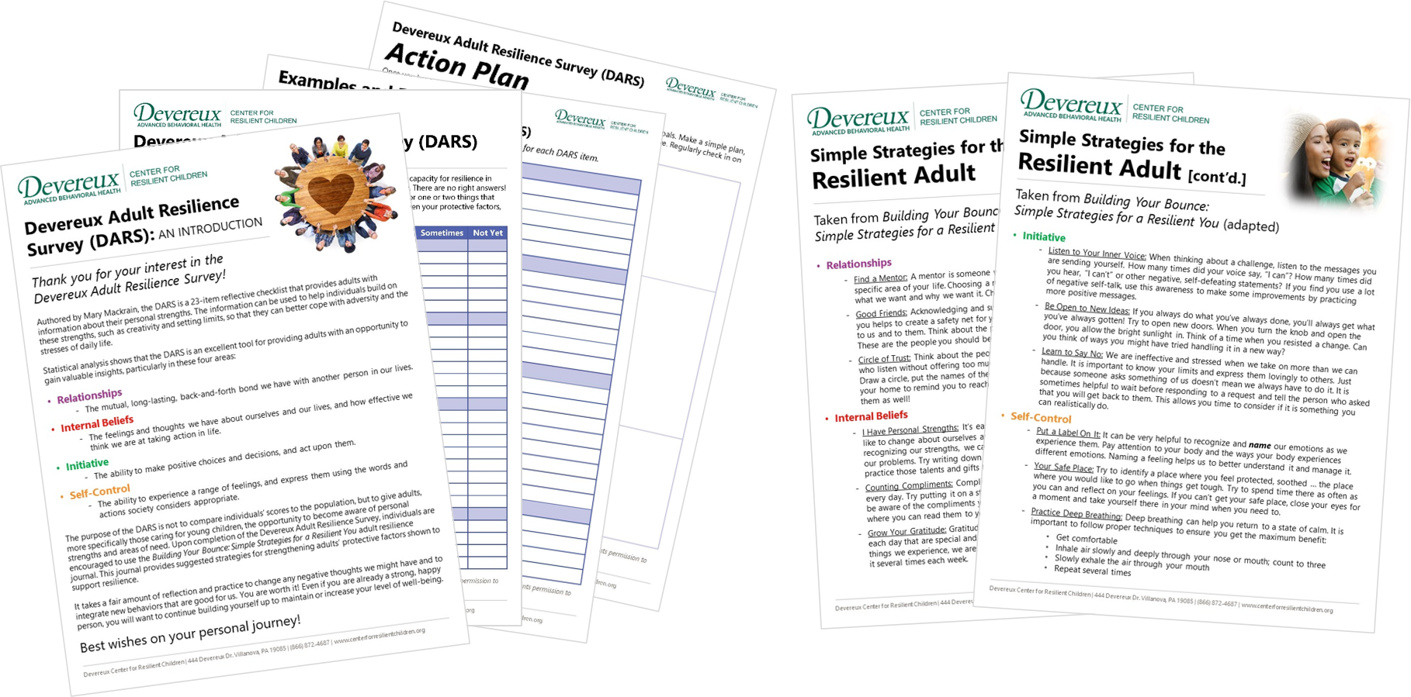
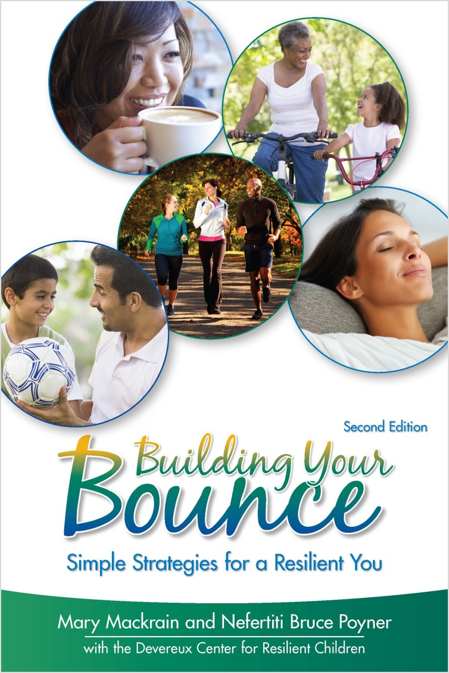
Adult Resilience
Notes:
Educating, caring for and parenting young children takes a great deal of energy, patience, creativity, kindness and love. It is difficult for adults to provide all of these things to young children if they are not also prioritizing their own well-being, happiness, and resilience. Based on this connection between the resilience of young children and the adults who care for them, the DECA Program includes resources to support adults through a process of self-reflection and action planning to strengthen their own protective factors.
The images on this slide show DECA Program resources that are available for adults to learn more about their own protective factors as well as strategy suggestions to target any identified goals. The Devereux Adult Resilience Survey (DARS) is a free tool (available on our website) that adults can use to self-reflect on four key protective factors: Healthy Relationships; Initiative; Internal Beliefs; and Self-regulation. Building Your Bounce: Simple Strategies for a Resilient You is a book that links strategies to the items on the DARS. To learn more about the Devereux Adult Resilience Initiative, visit our website at www.centerforresilientchildren.org.

Slide 27
Assess and plan online with the e-DECA
Notes:
As shared at the very start of this presentation, the DECA Program takes what the science and research tells us children need and has organized a practical framework that allows adults to use every day ordinary moments as opportunities to promote children’s protective factors.
Today, with advances in technology, the process can be even more simple by allowing technology to do the automated scoring and reporting so that the information from the DECA can be immediately used to put strategies and plans into place that build on children’s strengths and address areas of need.
Learn about the e-DECA on our website at www.centerforresilientchildren.org.
We also have a partnership with Conscious Discipline related to the e-DECA System. For those using Conscious Discipline practices, you can utilize the DECA, and then access Conscious Discipline strategies, all from within the e-DECA!

Slide 28
THANK YOU!

